Slide 1
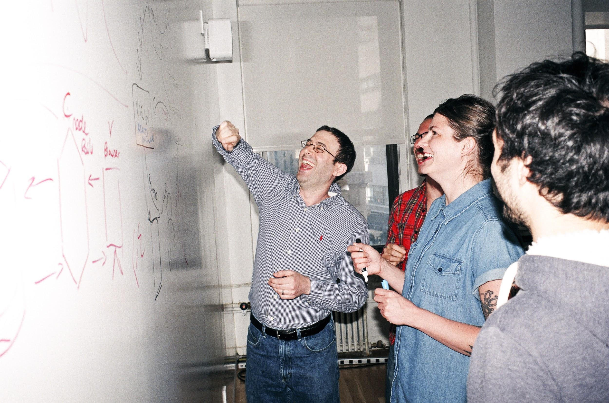

Welcome to General Assembly
WiFi GA Guest
Password yellowpencil
Notes:
[Leave this slide visible until presentation starts]

Slide 2
DATA SCIENCE
DAT11SYD
Lesson 16: Graph and Network Analysis How can we model and analyse inter-relationships of entities?

Slide 3
Course Plan
Final Countdown!

Slide 4
Lesson 16 - Review
FINAL PROJECT
- Final Project split into 4-parts: [Review with James 5mins]
(a) Real-world Problem Identification [Lesson 14]
(b) Data Cleaning [Lesson 15]
(c) Model & Validation [Lesson 16]
(d) Presentation & Storytelling [Lesson 17]
Lesson 18 – any final queries
Lesson 19 & 20 – Presenting final project back to class

Slide 5
Git & GitHub – 1 Pager Guide!

Slide 6
Agenda
Maths Recap
What are networks?
Graph theory
Graph metrics
Directed graphs
Graph transforms
Node closeness
Network analysis in Python
Lab

Slide 7



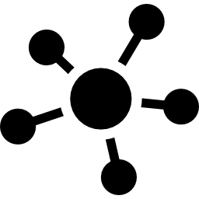
Learning Objectives
By the end of this lesson you should be able to ...
Explain what a network is
Discuss basic graph theory
Describe properties and metrics of graphs
Perform network analysis using Python

Slide 8

Let’s get started...

Slide 9
Maths Revision
Matrices ☺
A Matrix is a 2-dimensional list of things, arranged into columns and rows.
The general form is called a “Tensor” (can have any dimensionality) * 1D Tensor is called a “Vector” such as: c = [x , y , z] = [2 , 4 , 7] = 2i + 4j + 7k * 2D Tensor is called a “Matrix” (usually [rows x columns] given as “m x n”)
Lab – Markdown & Matrices

Slide 10
Networks
What are networks?
Examples?

Slide 11
Networks
Def: Network
1. an arrangement of intersecting horizontal and vertical lines.
synonyms: web, criss-cross, grid, lattice, net, matrix, mesh, webbing, tracery, trellis;
2. a group or system of interconnected people or things.
In data science, we tackle problems involving definition 2 using a conceptual model based on definition 1

Slide 12






Networks
Examples
social
biological
roads
power grids
infrastructure
web pages
mobile phone routing
Internet routing
vehicular flows

Slide 13

Social Networks
By Martin Grandjean - Grandjean, Martin (2014). "La connaissance est un réseau". Les Cahiers du Numérique 10 (3): 37-54. DOI:10.3166/LCN.10.3.37-54., CC BY-SA 3.0, https://commons.wikimedia.org/w/index.php?curid=29364647

Slide 14
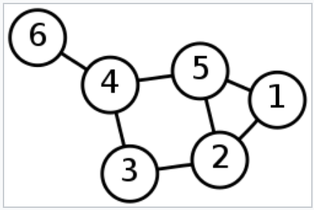
Graph Theory
Def: Graph
a mathematical structure used to model pairwise relations between objects
composed of
vertices or nodes
connected by 1 or more
links or edges
https://en.wikipedia.org/wiki/Graph_theory

Slide 15
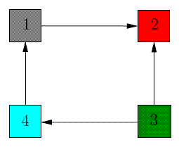
Graph Theory
Def: Directed Graph a graph with defined transitions between nodes
transitions can represent
flow of information
movement of quantities
example:
node 1 has in-degree = 1 (inflow from node 4), out-degree = 1 (outflow to node 2)
node 2 has in-degree = 2 (inflows from nodes 1 and 3), out-degree = 0
node 3 has in-degree = 0, out-degree = 2 (outflows to nodes 2 and 4)
node 4 has in-degree = 1 (inflow from node 3), out-degree = 1 (outflow to node 1)

Slide 16
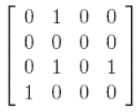
Graph Theory
Adjacency Matrix A (for a directed graph) a_{ij} represents a directed connection from node i to node j
to
from

Slide 17
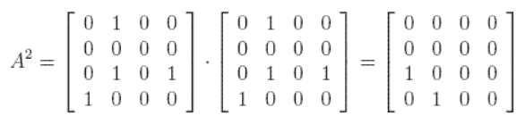
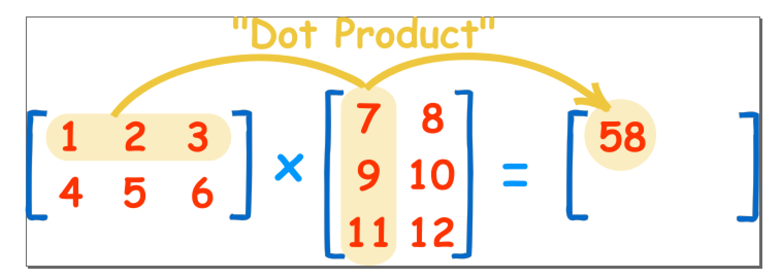
Graph Theory
Adjacency matrix for a 2-step path
What about for k steps?

Slide 18
Graph Theory
Adjacency matrix for a k-step path
is just A^{k}
adjacency matrices provide a powerful tool for computing paths, which we can make even more powerful by adding some concepts ...

Slide 19
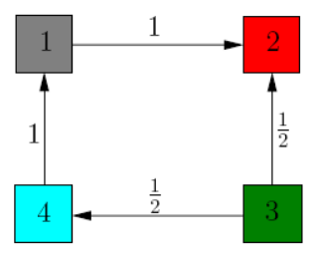
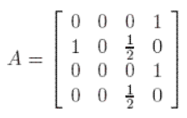
Graph Theory
Transition Matrix T an adjacency matrix that indicates quantitative flows between nodes
the out degree of a node is the number of edges flowing out
the in degree of a node is the number of edges flowing in
t_{ij} represents the proportion flowing from node i to node j

Slide 20
Graph Theory
Transition Matrix T an adjacency matrix that indicates quantitative flows between nodes
t_{ij} could also represent
an absolute quantity that flows from node i to node j
the probability of a transition from state i to state j
these generalisations allow an edge to have two directions (a 2-headed arrow):
e.g. t₂₄ = flow node 2 to 4 t₄₂ = flow node 4 to 2

Slide 21
Graph Theory
Weighted Edges
assigning a weight to each edge of the graph allows more complex representations
examples
proportion of items moving from one node to another
probability of a state transition from one node to another
distance, time, or cost associated with traversing a link between two nodes
compound weights
applications
GPS programming
travel-planning
times / cost optimisations
w1 = 0.9
w4 = 0.8
w2 = 2.1
w3 = 1.2

Slide 22
Graph Metrics
What measurable properties does a graph have?
?
?

Slide 23
Graph Metrics
What measurable properties does a graph/network have?
who/what the key actors (most important nodes) are in the network?
how would we calculate importance / centrality?
key actors

Slide 24
Graph Metrics
Calculating Closeness: 1. Calc shortest path to every other node s_{ij}
2. Farness = sum(shortest paths s_{ij} )
3. Closeness = (N-1) / Farness
Degree Centrality
"Popularity"
number of edges at a node
Closeness Centrality
the reciprocal of the sum of the shortest path distances from one node to all n-1 other nodes
the sum of distances depends on the number of nodes in the graph; so, closeness is normalized by the sum of minimum possible distances n-1.
higher values of closeness indicate higher centrality
Edges

Slide 25
Graph Metrics
Betweenness Centrality
the sum of the fraction of all-pairs shortest paths that pass through the node v
(i.e. is “v” a “hub”? Is v on the path between lots of things? - CBD etc)
Eigenvector Centrality
computes the centrality for a node from the centrality of its neighbours

Slide 26
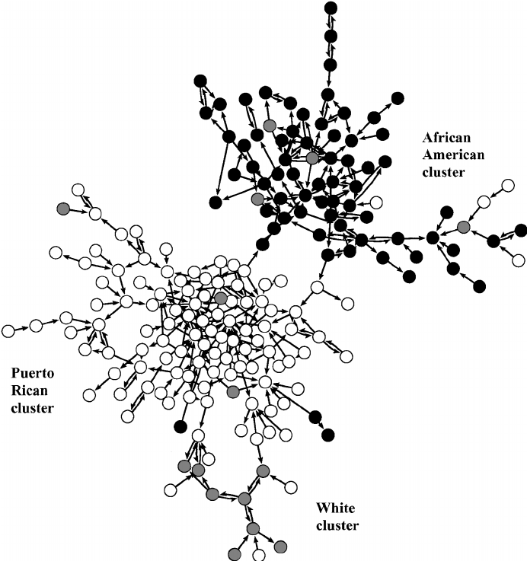
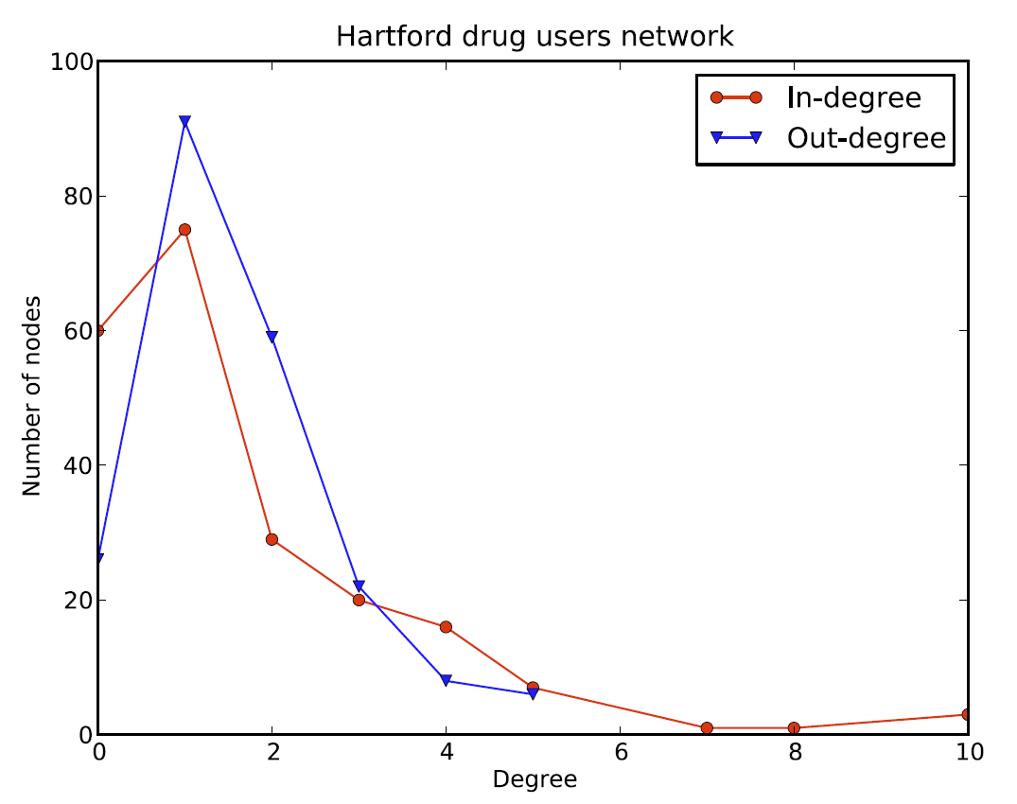
Graph Metrics
Weeks, Margaret & Clair, Scott & Borgatti, Stephen & Radda, Kim & Schensul, Jean. (2002). Social Networks of Drug Users in High-Risk Sites: Finding the Connections. AIDS and Behavior. 6. 193-206.

Slide 27
Grouping within Networks
How would we detect communities within a network?
e.g. Facebook friends
we met them at different places and stages in our lives
work, school, travelling, other friends Facebook friends, etc. How might we find sub-groupings (communities) among them?

Slide 28
Grouping within Networks
the criteria for finding communities is similar to that for finding clusters, but applied to edges rather than nodes
want to maximize intra-community edges while minimizing inter- community edges
formally, the algorithm tries to maximize the modularity of the network:
or (the fraction of edges that fall within the community) minus (the expected fraction of edges from a random distribution)

Slide 29
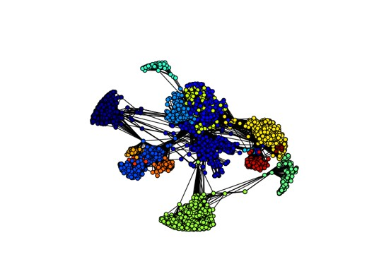
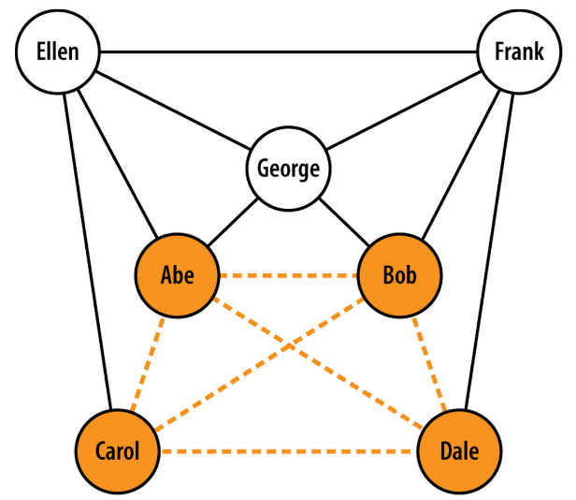
Grouping within Networks
‘communities’
or
‘cliques’
https://github.com/ptwobrussell/Mining-the-Social-Web-2nd-Edition

Slide 30

Practical Network Analysis

Slide 31
Network Analysis in Python
custom compiled code plus Python
Boost Graph
igraph
Graphviz
Python-based
NetworkX

Slide 32
Network Analysis using NetworkX
data structures
for representing many types of networks, graphs
flexibility
ideal for representing networks found in many different fields
easy interface to existing code bases
legacy algorithms in C, C++, and FORTRAN
productivity
user can focus on computational network modelling rather than software tool development

Slide 33
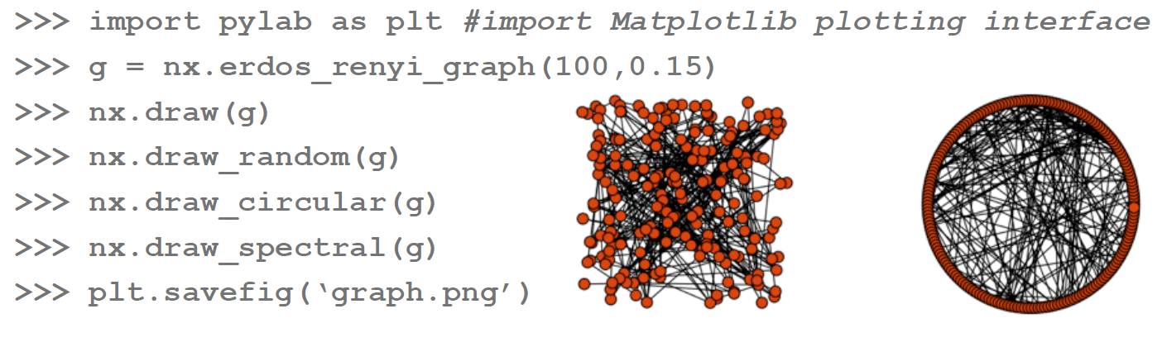
Network Visualisation using NetworkX
okay for small graphs

Slide 34
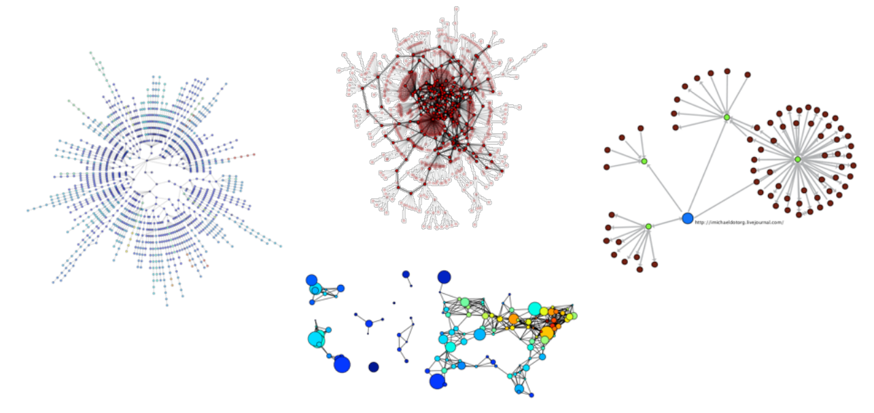
Network Visualisation using NetworkX
can export network data and draw with other programs e.g GraphViz, matplotlib

Slide 35
Network Analysis using NetworkX
Creating and populating a graph
# Instantiate a graph:
import networkx as nx
g = nx.Graph()
# Add one node:
g.add_node(1) # method of nx.Graph
# Add a list of nodes:
g.add_nodes_from([2 ,3])
# Add a container of nodes
h = nx.path_graph(10)
g.add_nodes_from(h) # g now contains the nodes of h
# Remove a specific node:
g.remove_node(2)

Slide 36
Network Analysis using NetworkX
A node can be any hashable object: strings, numbers, files, functions, etc.
import math g.add_node(math.cos) # cosine function fh = open(’tmp.txt’,’w’) # file handle g.add_node(fh) print g.nodes()
[<built-in function cos>, <open file ’tmp.txt’, mode ’w’ at 0x30dc38>]
g.add_node(’a’)

Slide 37
Network Analysis using NetworkX
Adding edges to a graph
# Single edge g.add_edge(1,2) e = (2,3) g.add_edge(*e) # unpack edge tuple
# List of edges g.add_edges_from([(1 ,2) ,(1 ,3)])
# Container of edges g.add_edges_from(h.edges())
# In contrast, you can remove any edge of the graph g.remove_edge(1,2)

Slide 38
Network Analysis using NetworkX
Properties of a graph
g.number_of_nodes() # also g.order() 4
g.number_of_edges() # also g.size() 2
g.nodes() [1, 2, 3, ‘a’]
g.edges() [(1, 2), (1, 3)]
g.neighbors(1) [2, 3]
g.degree(1) 2

Slide 39
Network Analysis using NetworkX
Graph, Node, and Edge Attributes
G = nx.Graph(day="Friday")
G.graph['day'] = "Monday"

Slide 40
Network Analysis using NetworkX
Node Attributes
On access (only), the nodes of a NetworkX graph behave like the primary keys of a Python dict
g.add_node(1, time=’5pm’) g.node[1][’time’] ’5pm’
g.node[1]
{’time’: ’5pm’}
G.add_nodes_from([3], time='2pm')
G.nodes[1]['room'] = 714 G.nodes.data() NodeDataView({1: {'room': 714, 'time': '5pm'}, 3: {'time': '2pm'}})

Slide 41
Network Analysis using NetworkX
Edge Attributes
g.add_edge(1, 2, weight=4.0) g[1][2] {‘weight’: 4.0}
g[1][2][‘weight’] = 5.0 # change the weight of an existing edge g[1][2] {‘weight’: 5.0}
examples:
modelling road networks
weight = distance
modelling social networks
weight = strength of association

Slide 42
Network Analysis using NetworkX
Note and Edge Iterators
for node in g.nodes(): print node, g.degree(node)
for n1, n2, attr in g.edges(data=True): # unpacking print n1, n2, attr[‘weight’]

Slide 43
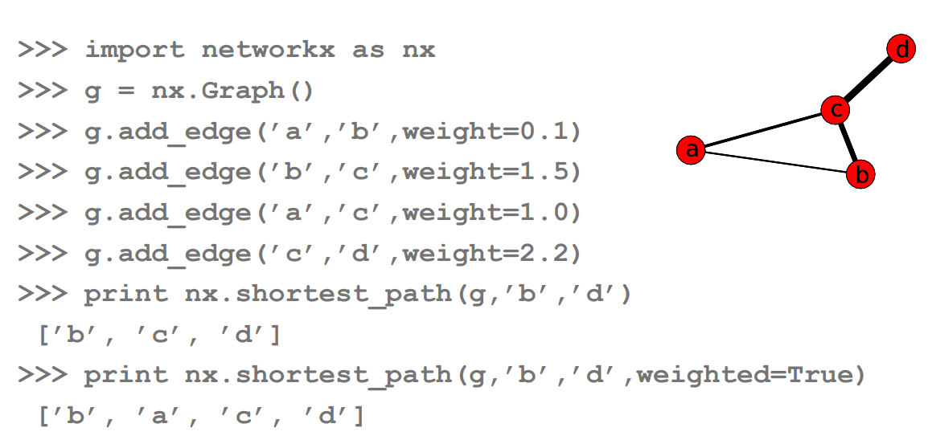
Network Analysis using NetworkX
Dijkstra’s algorithm https://youtu.be/_lHSawdgXpI
finds the shortest path in a weighted or unweighted network:

Slide 44
Network Analysis using NetworkX
Directed Graphs
dg = nx.DiGraph() dg.add_weighted_edges_from([(1, 4, 0.5), (3, 1, 0.75)])
dg.out_degree(1, weighted=True) 0.5
dg.degree(1, weighted=True) 1.25
dg.successors(1) [4]
dg.predecessors(1) [3]
examples:
the link structure of a website
natural language modelling
business process modelling
assembly line control

Slide 45
Network Analysis using NetworkX
Multigraphs
allow multiple edges between any pair of nodes
mg = nx.MultiGraph() mg.add_weighted_edges_from([(1,2,.5), (1,2,.75), (2,3,.5)]) mg.degree(weighted=True) {1: 1.25, 2: 1.75, 3: 0.5}

Slide 46
Network Analysis using NetworkX
Conversion to undirected graph
some algorithms don’t support directed or multiple edges
to use these on a directed graph or multigraph it must first be converted to an undirected graph
Graph.to_undirected()

Slide 47
Network Analysis using NetworkX
Graph Operators
subgraph(G, nbunch) induce subgraph of G on nodes in nbunch (an iterable)
union(G1,G2) graph union
disjoint_union(G1,G2) graph union assuming all nodes are different
cartesian_product(G1,G2) return Cartesian product graph
compose(G1,G2) combine graphs identifying nodes common to both
complement(G) graph complement
create_empty_copy(G) return an empty copy of the same graph class
convert_to_undirected(G) return an undirected representation of G
convert_to_directed(G) return a directed representation of G

Slide 48
Network Analysis using NetworkX
Graph Generators
petersen=nx.petersen_graph() # small famous graphs tutte=nx.tutte_graph() maze=nx.sedgewick_maze_graph() tet=nx.tetrahedral_graph()
K_5=nx.complete_graph(5) # classic graphs K_3_5=nx.complete_bipartite_graph(3,5) barbell=nx.barbell_graph(10,10) lollipop=nx.lollipop_graph(10,20)
er=nx.erdos_renyi_graph(100,0.15) # random graphs ws=nx.watts_strogatz_graph(30,3,0.1) ba=nx.barabasi_albert_graph(100,5) red=nx.random_lobster(100,0.9,0.9)

Slide 49
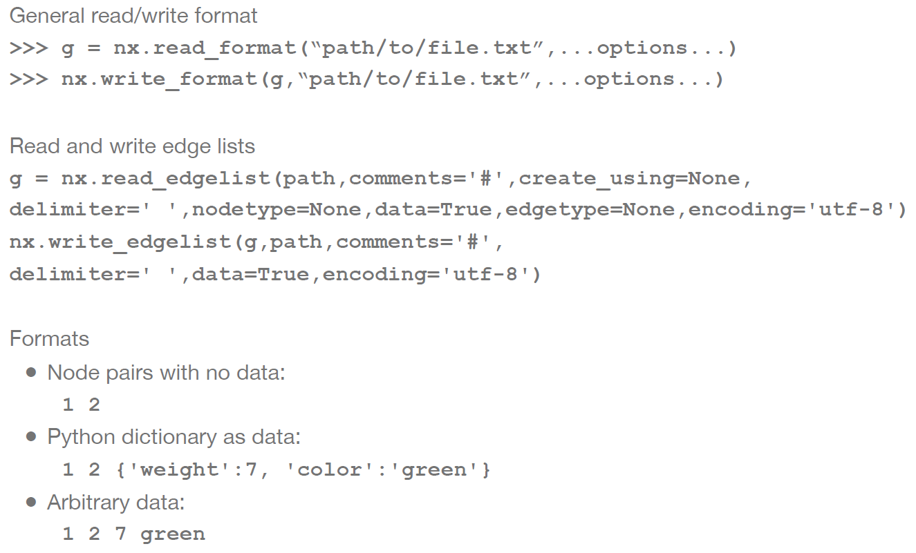
Network Analysis using NetworkX

Slide 50

Lab: Graph and Network Analysis
with NetworkX and Facebook SDK

Slide 51
Summary
brief introduction to graphs and networks
types of graphs
properties of graphs / networks
metrics for nodes and paths
exposure to NetworkX
creating and visualising graphs
computing graph properties and metrics
basic algorithms

Slide 52
Task List
Read the following articles:
http://www.wired.com/2016/01/googles-go-victory-is-just-a-glimpse-of-how-powerful-ai-will-be/
http://www.wired.com/2014/01/geoffrey-hinton-deep-learning https://sites.google.com/site/deepernn/home/blog/briefsummaryoſthepaneldiscussionatdlworkshopicml2015
Install TensorFlow

Slide 53

Q&A

Slide 54
Additional Resources
NetworkX
http://networkx.lanl.gov/
https://networkx.github.io/documentation
GraphViz
http://www.graphviz.org/
Jupyter Notebooks from Mining the Social Web
https://github.com/ptwobrussell/Mining-the-Social-Web-2nd-Edition (warning: APIs have changed since last updates)
Dataset for Hartford Drug Users
https://sites/google.com/site/ucinetsoftware/datasets/covert-networks/drugnet

Slide 55

Thank You!

